Slide 1
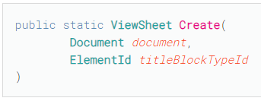
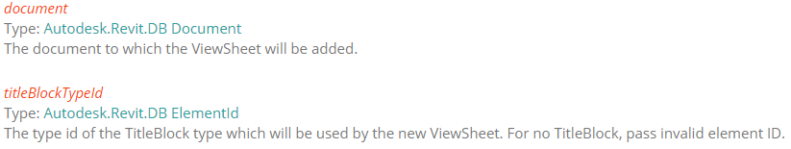
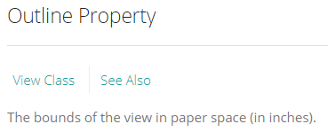


ViewSheet & Outline Property
ViewSheet viewSheet = ViewSheet.Create(doc, titleblock.Id);
BoundingBoxUV outline = viewSheet.Outline;

Slide 2
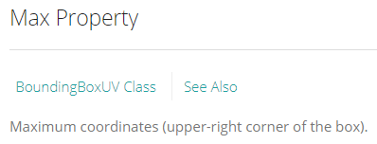
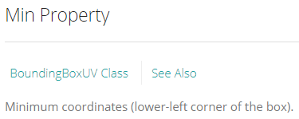
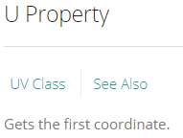
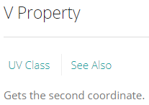
ViewSheet Coordinate System
UV max = outline.Max;
UV min = outline.Min;
double maxU = max.U;
double maxV = max.V;
double minU = min.U;
double minV = min.V;
U Axis
max value
Max UV
Sheet Outline
V Axis
Min UV
0

Slide 3
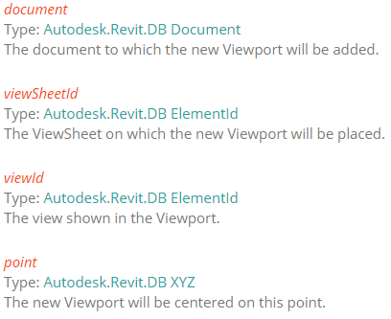
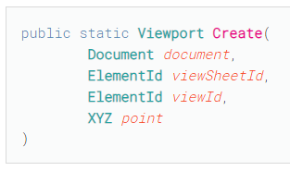
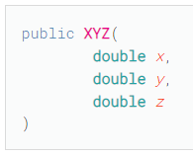
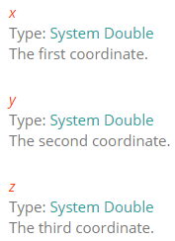
Viewport & Location Distribution on ViewSheet
Viewport viewPort = Viewport.Create(doc, viewSheet.Id, view.Id, location);
UV & XYZ Relationship
X value collect from net U value (max - min).
Y value collect from net V value (max - min).
Z value is zero. (2D Environment)
A is a divisible value related to X, For multiple viewports on a same sheet, A value is varies.
B is a divisible value related to Y, For multiple viewports on a same sheet, B value is varies.
So, X value formula is (maxU – minU)/A and Y value formula is (maxU – minU)/B
XYZ location = XYZ( (maxU – minU)/A , (maxU – minU)/B , 0 );

Slide 4
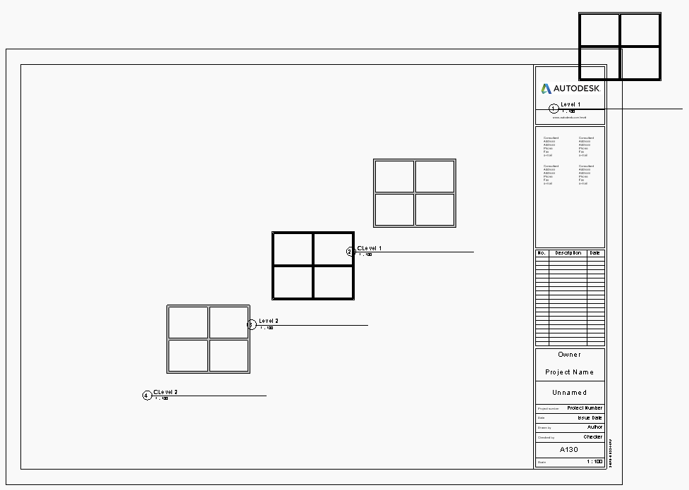
Viewport Location on Sheet
U Axis
1,1,0
A,B,0
A, B are divisible values inside X and Y vales formula.
1.5,1.5,0
V Axis
2,2,0
3,3,0

Slide 5
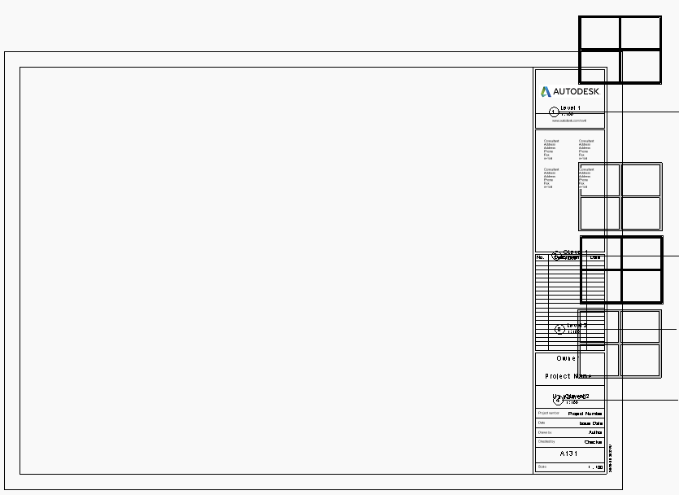
Viewport Location on Sheet
1,1,0
A,B,0
U Axis
A, B are divisible values inside X and Y vales formula.
1,1.5,0
V Axis
1,2,0
1,3,0

Slide 6
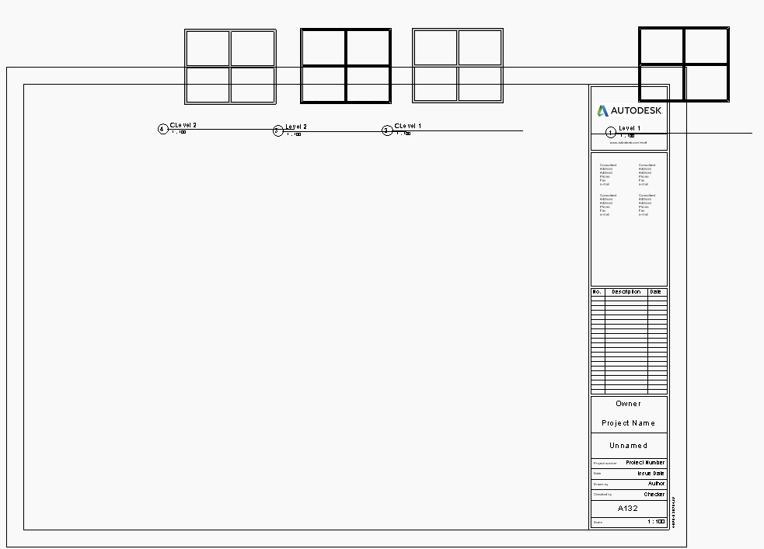
Viewport Location on Sheet
U Axis
A,B,0
3,1,0
2,1,0
1.5,1,0
1,1,0
A, B are divisible values inside X and Y vales formula.
V Axis

